Slide 1
Capstone Project
Unsupervised ML
BOOK RECOMMENDATION SYSTEM
Presented By:
Agniv Paul

Slide 2
Content
• Problem statement
• Data Summary
• Analysis of different datasets
• Data Cleaning
• Outlier treatment
• Imputing missing values
• Different Recommendation Model
• Challenges
• Conclusion
• Future Scope

Slide 3

Problem Statement
During the last few decades, with the rise of Youtube, Amazon, Netflix, and many other such web services, recommender systems have become much more important in our lives in terms of providing highly personalized and relevant content.
The main objective is to create a recommendation system to recommend relevant books to users based on popularity and user interests.

Slide 4
Data Summary
The dataset is comprised of three csv files:: User_df, Books_df, Ratings_df
Users_dataset.
User-ID (unique for each user)
Location (contains city, state and country separated by commas)
Age
Shape of Dataset - (278858, 3)
Books_dataset
• ISBN (unique for each book)
• Book-Title
• Book-Author
• Year-Of-Publication
• Publisher
Ratings_dataset.
• User-ID
• ISBN
• Image-URL-S
• Image-URL-M
• Image-URL-L
• Shape of Dataset - (271360, 8)
• Book-Rating
• Shape of Dataset - (1149780, 3)

Slide 5
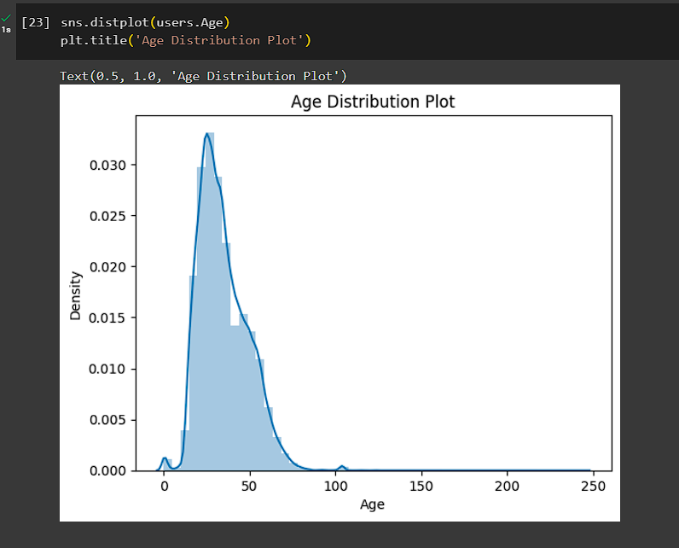
Observations from Users_df (Age)
The Age given here is from 0 to 250. Thus Outliners in Age Column

Slide 6
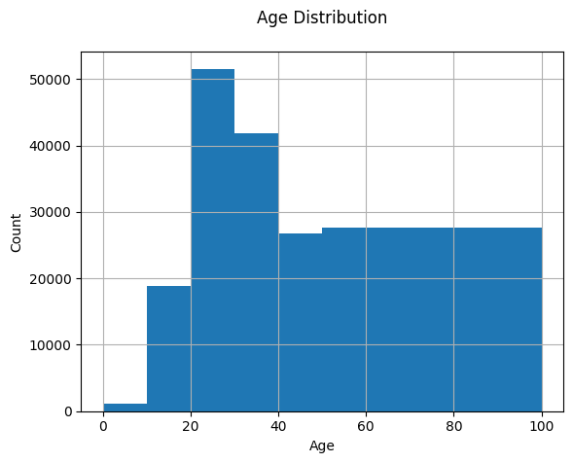
Observations from Users_df (Age)
• The Age range distribution is right skewed
• Most active readers lie in age group 20- 40

Slide 7
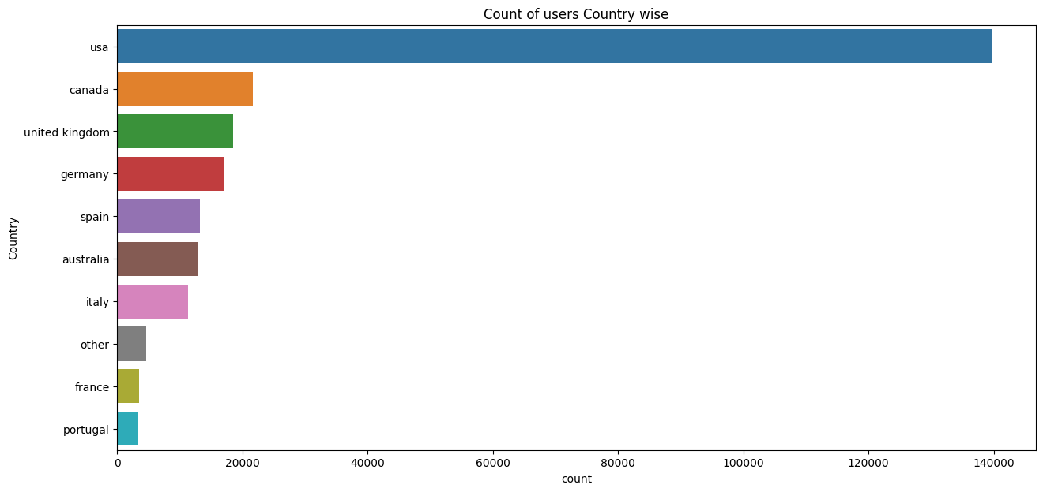
Observations from Users_df (Location)
• Splitting Location column and analysing country.
• Most active readers are from USA.

Slide 8
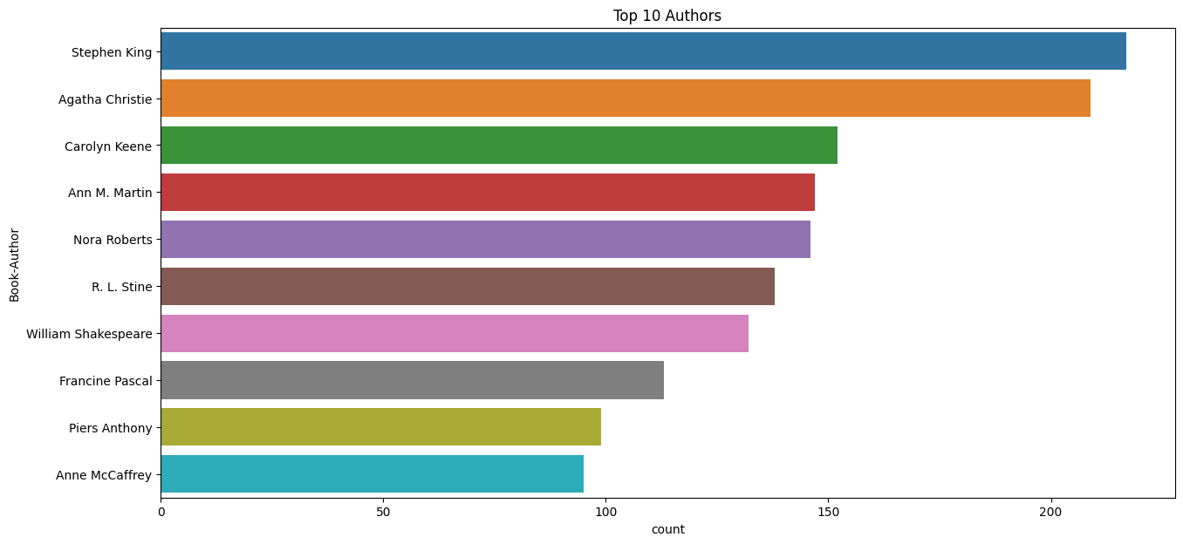
Observations from Book_df (Authors)
Stephen King wrote highest number of books in our given dataset

Slide 9
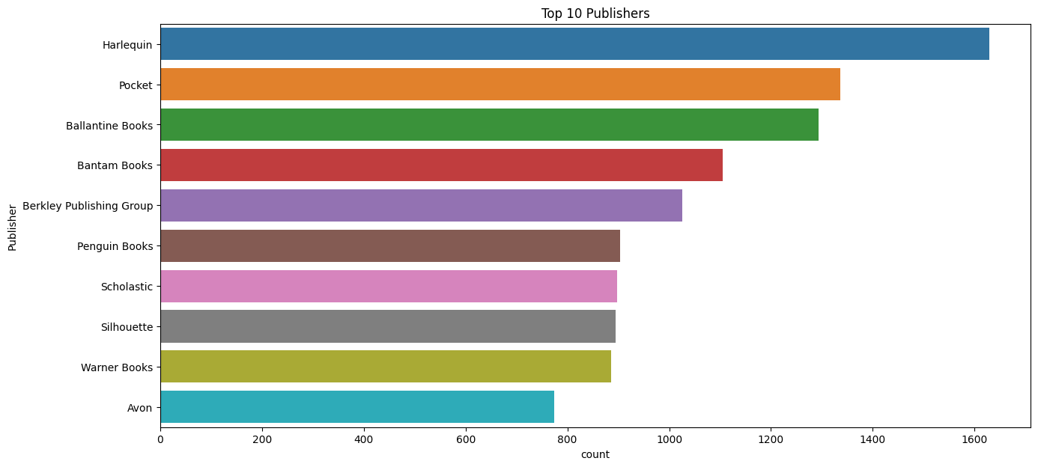
Observations from Book_df (Publishers)
Harlequin published highest number of books in our given dataset

Slide 10
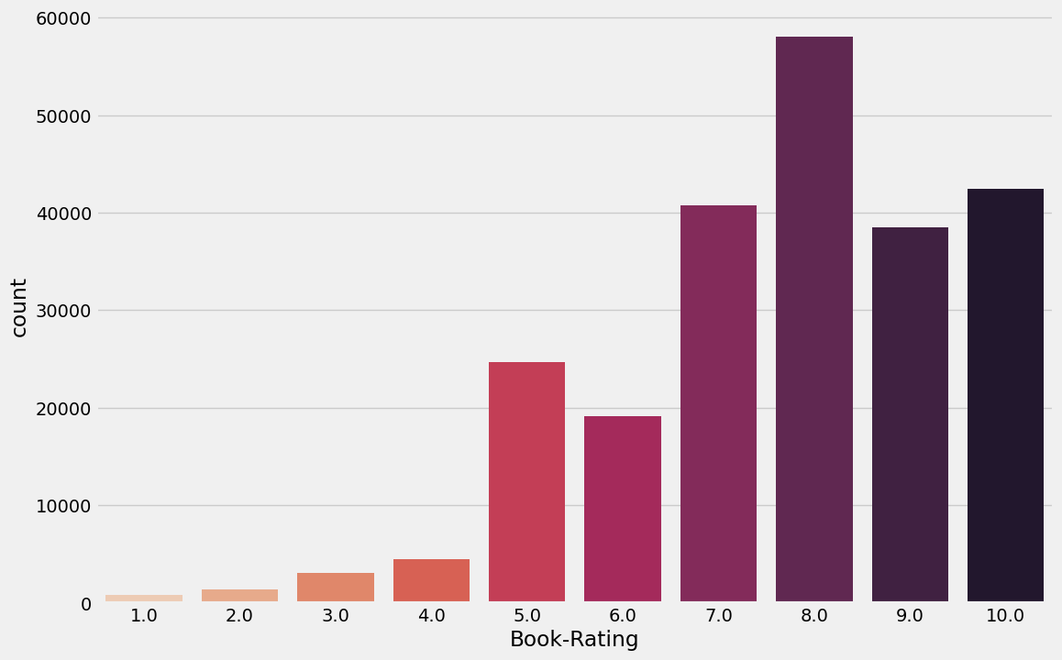
Observations from Ratings_df (Book_Rating)
• Higher ratings are more common amongst users
• Rating 8 has been rated the highest number of times

Slide 11
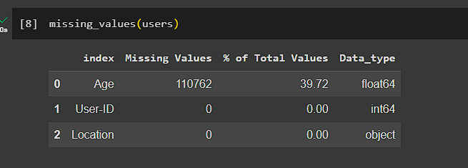
Data Cleaning
Null Value Imputation: Age column has 40% missing values

Slide 12
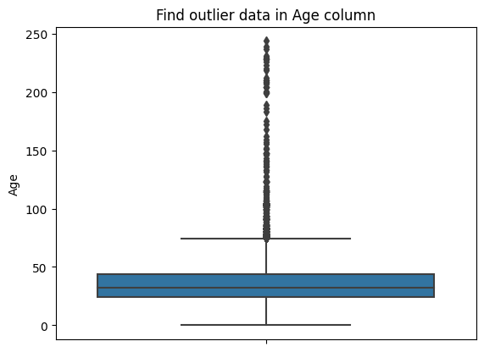
Imputing missing values
• Outliers in Age column
• Age has positive Skewness (right tail) so we can use median to fill Nan values,

Slide 13
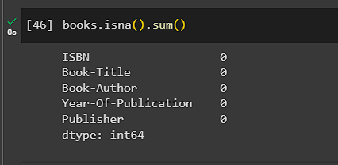
Data Cleaning
1. Null Value Imputation:

Slide 14
Different Models
1.)Popularity Based Recommendation
Book weighted average formula:
Weighted Rating(WR)=[vR/(v+m)]+[mC/(v+m)]
Where,
v is the number of votes for the books;
m is the minimum votes required to be listed in the chart; R is the average rating of the book; and C is the mean vote across the whole report.

Slide 15
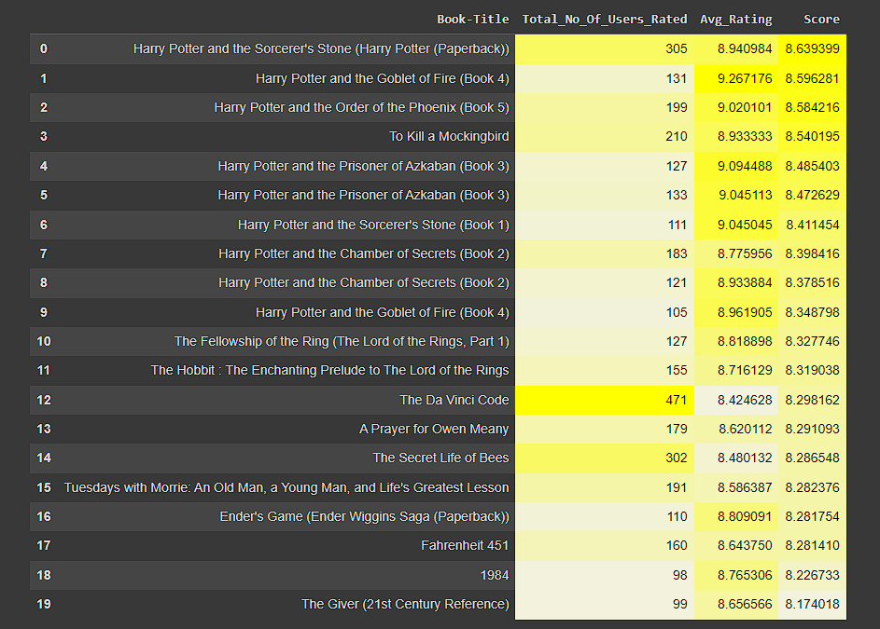
Different Models
The Popularity based recommender provide a general chart of recommended books to all the users. They are not sensitive to the interests and tastes of a particular user.

Slide 16
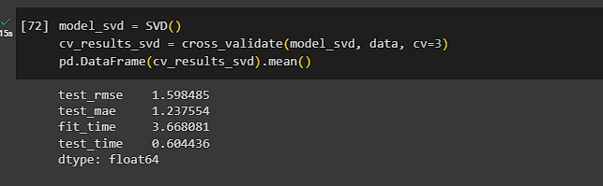
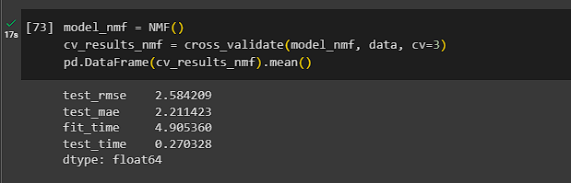
Different Models
2.)Model based collaborative filtering
SVD
NMF

Slide 17
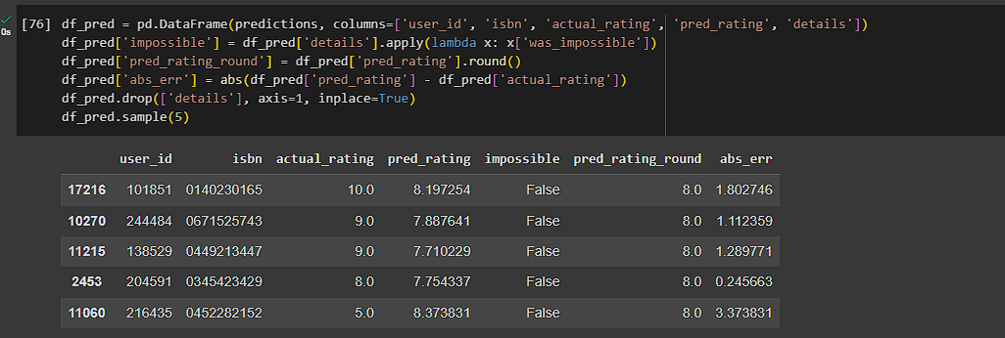
Different Models
SVD Model Results
Distribution of actual and predicted ratings in the test set According to the distribution of actual ratings of books in the test set, the biggest part of users give positive scores - between 7 and 10. The mode equals 8 but count of ratings 7, 9, 10 is also noticeable. The distribution of predicted ratings in the test set is visibly different. One more time, 8 is a mode but scores 7, 9 and 10 are clearly less frequent. It shows that the recommender system is not perfect and it cannot reflect the real distribution of book ratings.

Slide 18
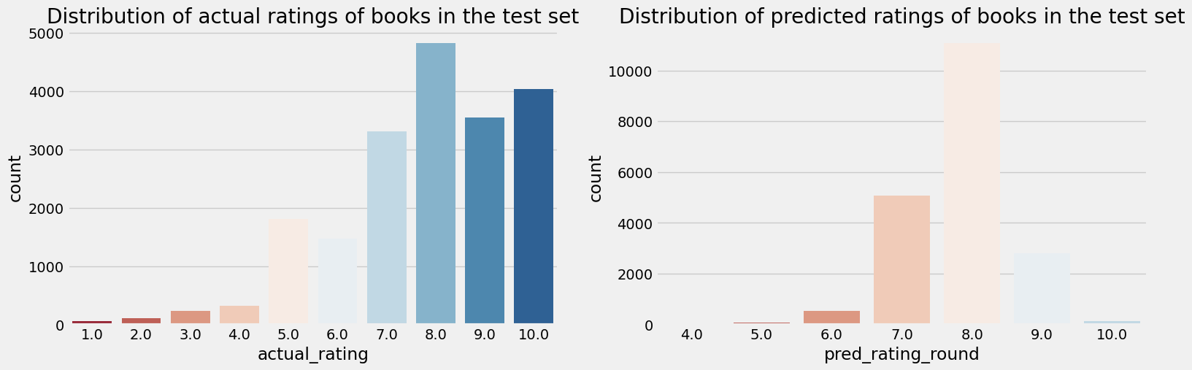
Absolute error of predicted ratings
The distribution of absolute errors is right-skewed, showing that the majority of errors is small: between 0 and 1. There is a long tail that indicates that there are several observations for which the absolute error was close to 10. How good/bad the model is with predicting certain scores? As expected from the above charts, the model deals very well with predicting score = 8 (the most frequent value). The further the rating from score = 8, the higher the absolute error. The biggest errors happen to observations with scores 1 or 2 which indicates that probably the model is predicting high ratings for those observations.
Different Models
SVD Model Results

Slide 19
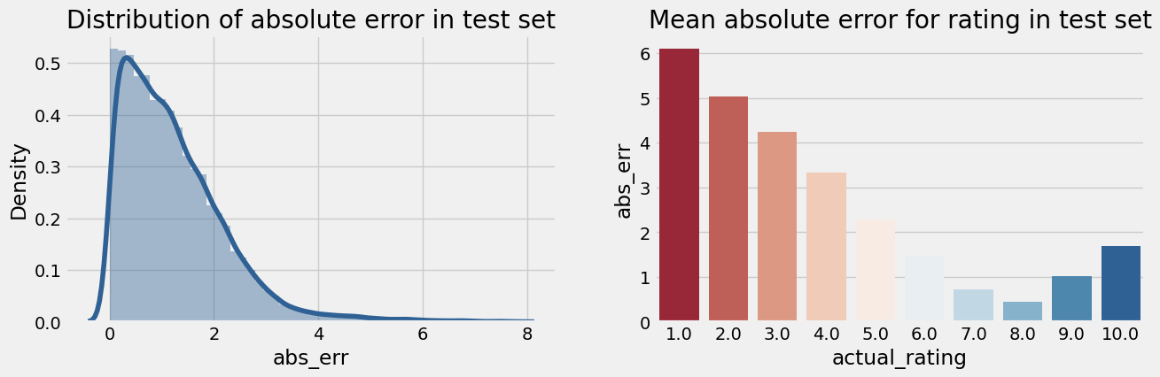
Different Models
SVD Model Results
Analysis of predicted ratings of a particular user
For this part of the analysis, the user with id 193458 was selected. By analyzing book ratings by this user, it can be noted that he/she likes diverse types of readings: English romantic novels (Pride and Prejudice, Sense and Sensibility), fantasy (Narnia) as well as historical novels (Schindler's List). Among the recommended books there are other works from Narnia's series, two historical novels and one romance which correlates with user's previous preferences.

Slide 20
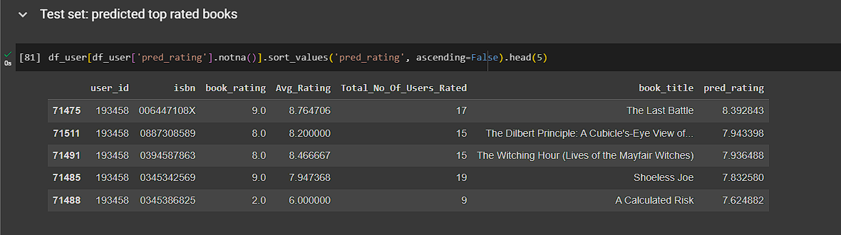
Different Models
User-ID - 193458
Test set: predicted top rated books

Slide 21
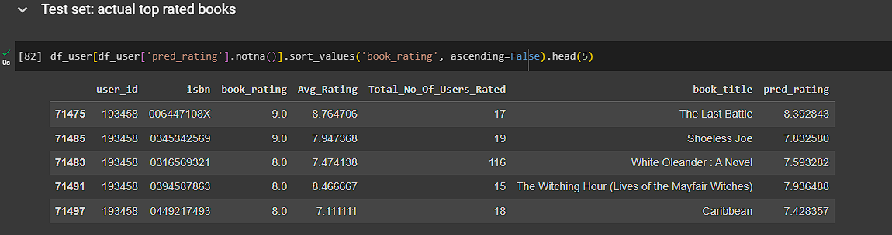
Different Models
Test set: actual top rated books

Slide 22
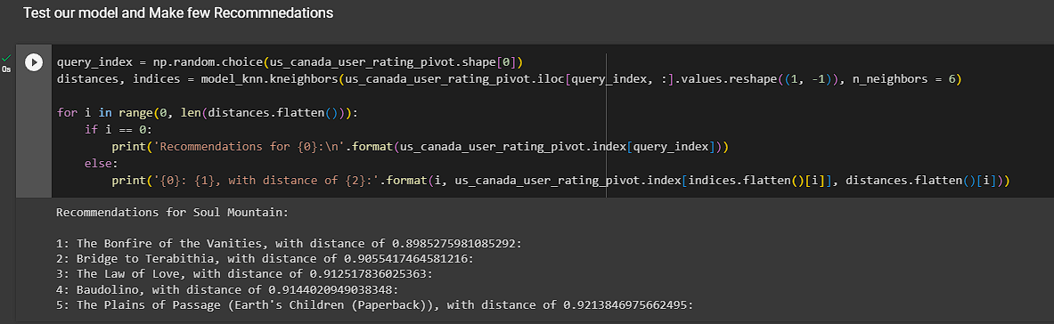
Collaborative Filtering-(Item-Item based)
3.)Collaborative Filtering-(Item-Item based)
Cosine Similarity
Nearest Neighbour

Slide 23


Different Models
SVD and Correlation
Recommendations for Harry Potter and the Sorcerer's Stone (Book 1)
Input
Output

Slide 24
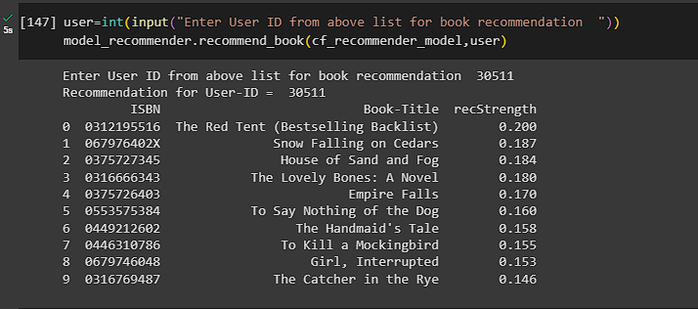
Different Models
4.)Collaborative Filtering-(User-Item based)

Slide 25
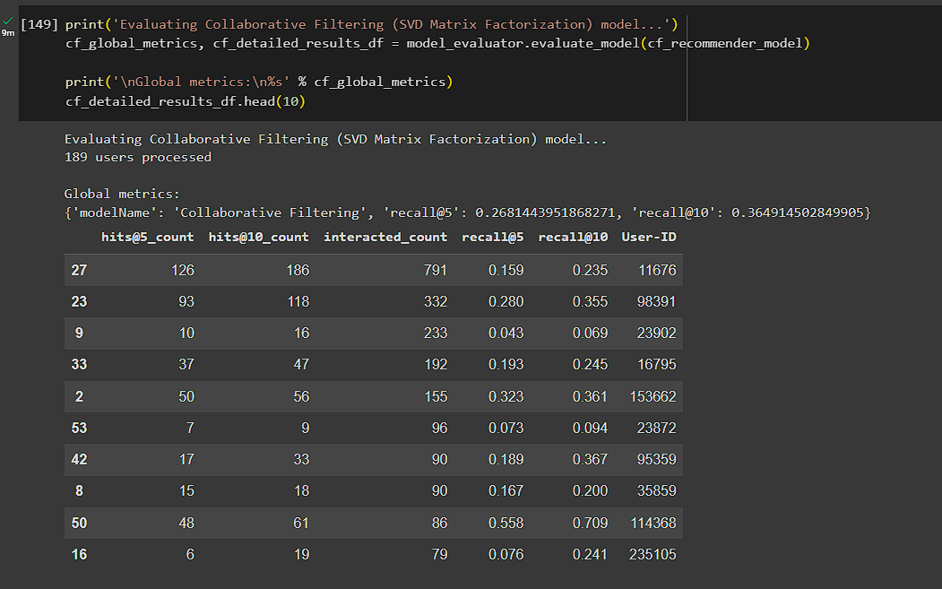
Different Models
Model Results

Slide 26
Conclusion
In EDA, the Top-10 most rated books were essentially novels. Books like The Lovely Bone and The Secret Life of Bees were very well perceived.
Majority of the readers were of the age bracket 20-35 and most of them came from North American and European countries namely USA, Canada, UK, Germany and Spain.
If we look at the ratings distribution, most of the books have high ratings with maximum books being rated 8. Ratings below 5 are few in number.
Author with the most books was Agatha Christie, William Shakespeare and Stephen King.
For modelling, it was observed that for model based collaborative filtering SVD technique worked way better than NMF with lower Mean Absolute Error (MAE) .

Slide 27
Recommendation
A recommendation system helps an organization to create loyal customers. The recommendation system today are very powerful that they can handle the new customer too who has visited the site for the first time. They recommend the products which are currently trending or highly rated and they can also recommend the products which bring maximum profit to the company.

Slide 28
Challenges
Handling of sparsity was a major challenge as well since the user interactions were not present for the majority of the books.
Understanding the metric for evaluation was a challenge as well.
Since the data consisted of text data, data cleaning was a major challenge in features like Location etc..
Decision making on missing value imputations and outlier treatment was quite challenging as well.

Slide 29
Future Scope
Given more information regarding the books dataset, namely features like Genre, Description etc, we could implement a content-filtering based recommendation system and compare the results with the existing collaborative-filtering based system.
We would like to explore various clustering approaches for clustering the users based on Age, Location etc., and then implement voting algorithms to recommend items to the user depending on the cluster into which it belongs.

Slide 30
Thank You

